Slide 1





Design and Implementation of an AM Modulator and Demodulator
Presented By
Tanzila Khan (25)
Muhaiminul Islam (43)
Fayek Ahmed (57)

Slide 2


TABLE OF CONTENTS
01.
Introduction
02.
Introduction
03.
Construction of an AM Modulator
04.
Construction of an AM Demodulator
06.
Experimental Setup
05.
PCB Design and Fabrication
Oscilloscope Observations
07.

Slide 3

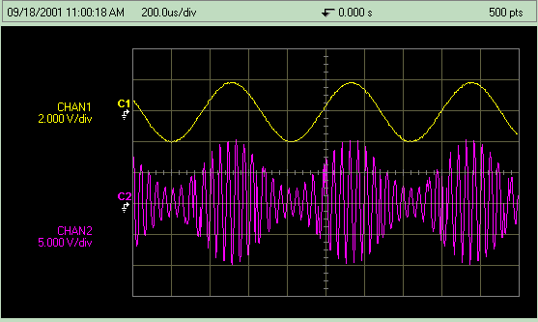
INTRODUCTION
Amplitude Modulation (AM) is a technique in which the amplitude of a high-frequency carrier wave is varied in proportion to the instantaneous amplitude of a lower-frequency information signal.
Demodulation is the process of extracting the original modulating signal from the modu-
lated carrier wave.
.

Slide 4
Modulator
Amplitude Modulation (AM):
  Modifies carrier amplitude based on a modulating signal.
  Enables long-distance transmission using high-frequency carriers.
Mathematical Expression:
  𝑠(𝑡)=[𝐴𝑐​+𝐴𝑚cos⁡(𝜔𝑚𝑡)]cos⁡(𝜔𝑐𝑡)
    𝐴𝑐​ : Carrier amplitude
    𝐴𝑚 ​: Modulating signal amplitude
    𝜔𝑐​ : Carrier angular frequency
    𝜔𝑚​ : Modulating signal angular frequency
Key Components:
  Mixing Networks: Combine signals.
  Nonlinear Devices: Implement modulation.
  Tuned Circuits: Shape the carrier.
Objective:
  Create a waveform where carrier amplitude reflects the modulating signal.

Slide 5

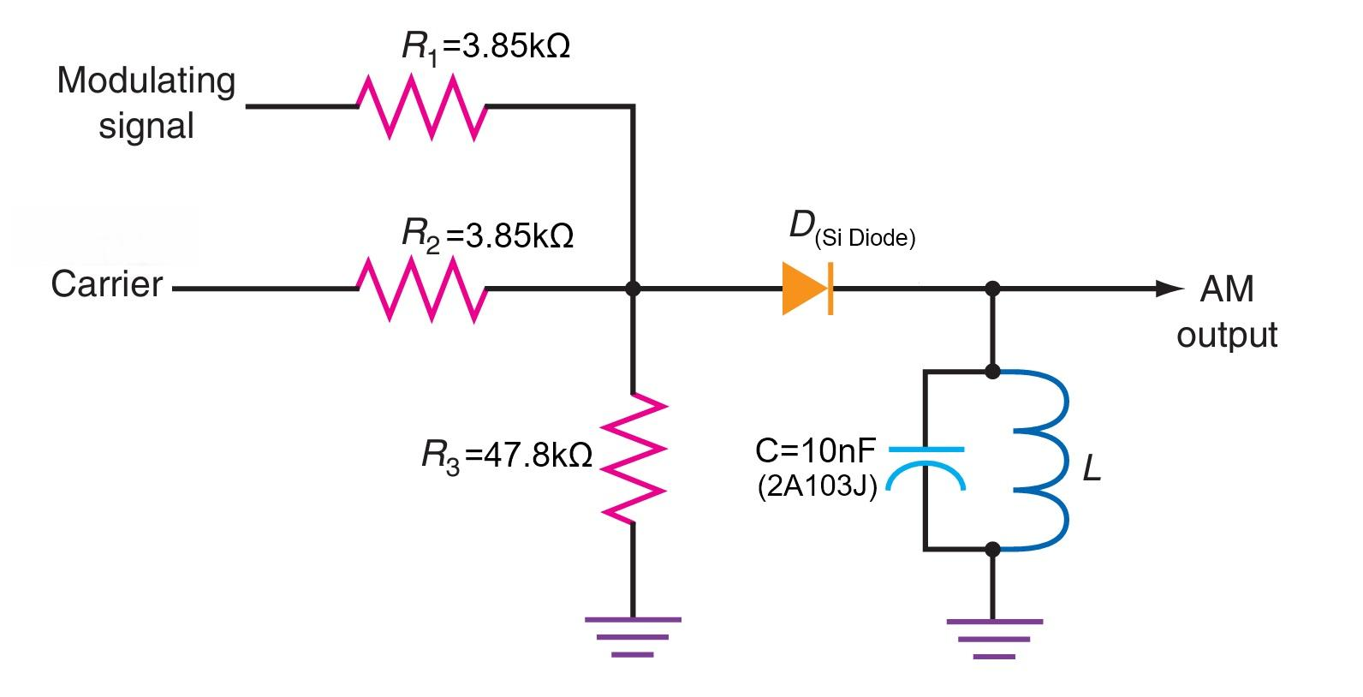
Constructing an AM Modulator
Component Selection
• Diode: 1N4148 (fast switching diode).
• Inductor (L): Got a shielded inductor that was available on the market and would
resonate with the frequencies available at our function generators.
• Capacitor (C): 10nF Capacitor paired with L to form an LC resonator.
• Resistors: Various values for biasing and limiting current.

Slide 6
Constructing an AM Modulator
Modulator Implementation Process
Resistive Mixing:
  Combine carrier and modulating signals with two resistors to form a composite signal.
Diode Rectification:
  Use a 1N4148 diode to pass positive pulses, varying with the modulating signal.
LC Tank Circuit:
  Connect an LC circuit to resonate at the carrier frequency, reconstructing the waveform.
Amplitude Modulation:
  Carrier amplitude varies with the modulating signal, creating an AM waveform.

Slide 7
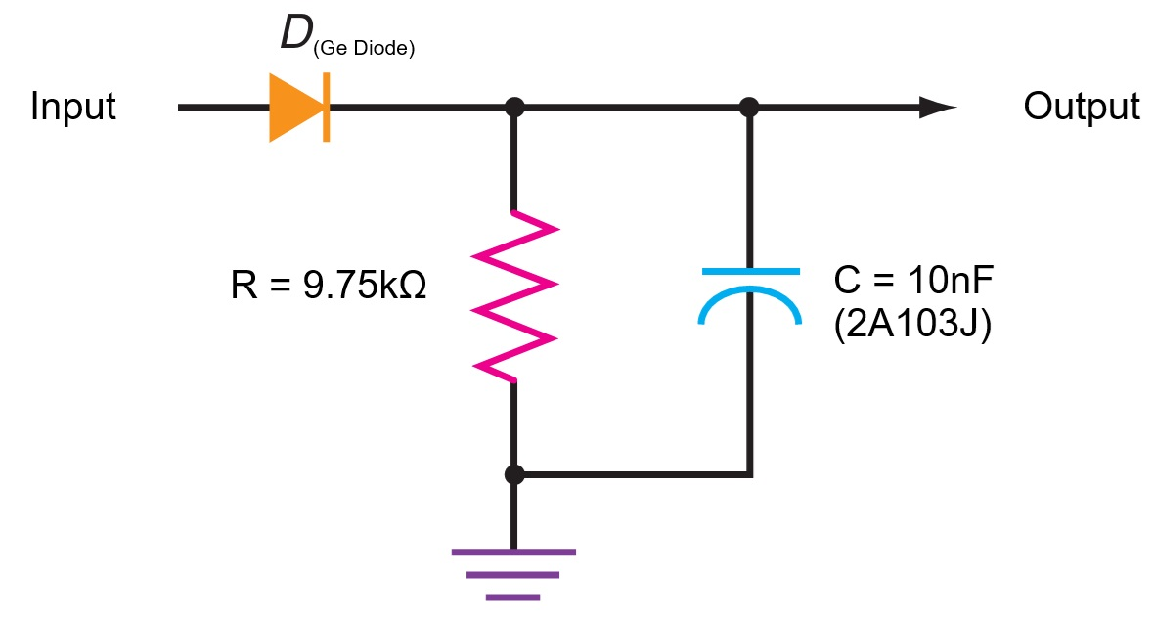
Demodulator
Purpose of Demodulation:
  Extract the original modulating signal from the modulated carrier wave.
Envelope Detector:
  A simple and effective circuit for AM demodulation.
Key Components:
  Diode: Rectifies the incoming AM signal.
  RC Low-Pass Filter: Smooths the rectified signal to recover the modulating signal.
Time Constant (𝜏=𝑅𝐶):
  Chosen to effectively track the envelope without distortion.

Slide 8
Construction of Demodulator
Component Selection
Diode: 1N34 (Germanium diode).
Capacitor (C): 10nF Capacitor
Resistor (R): 10kΩ resistor paired with C to create an RC circuit

Slide 9
Construction of Demodulator
Implementation
Diode Rectification:
  Conducts on positive half-cycles of the AM signal, creating pulses that follow the envelope.
RC Low-Pass Filtering:
  Capacitor charges to pulse peaks and discharges through a resistor.
  Time constant (𝜏=𝑅1𝐶1τ=R1C1) ensures the capacitor tracks the envelope, not the carrier.
Recovered Signal:
  The capacitor's voltage forms a smooth waveform, approximating the original modulating signal.
  High-frequency ripple is minimal if the carrier frequency is much higher than the modulating signal.

Slide 10
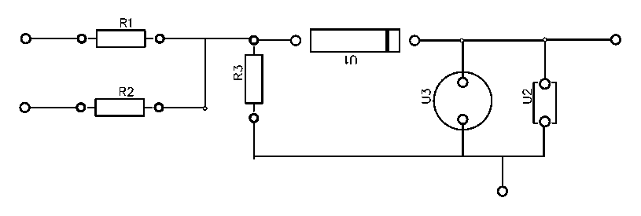
PCB Design and Fabrication
Layout Considerations
• Short Traces: High-frequency signals (carrier) are sensitive to stray inductances; we kept the traces short.
• Ground Plane: A solid ground plane on one side helped reduce noise coupling.
• Component Placement: Grouped the modulator components (diode, LC tank, transistor) close together. Similarly, the demodulator components (diode, RC filter) are placed in a separate section.

Slide 11
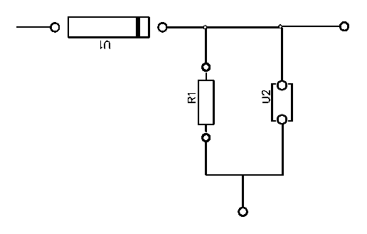
PCB Design and Fabrication
PCB Etching Process
Cleansing:
  Removed oxidation with sandpaper and isopropyl alcohol.
Layout Transfer:
  Applied nail polish to draw the PCB layout, protecting areas from etching.
Etching:
  Submerged in ferric chloride to dissolve exposed copper.
Drilling and Soldering:
  Drilled holes and soldered components, ensuring correct polarity.

Slide 12
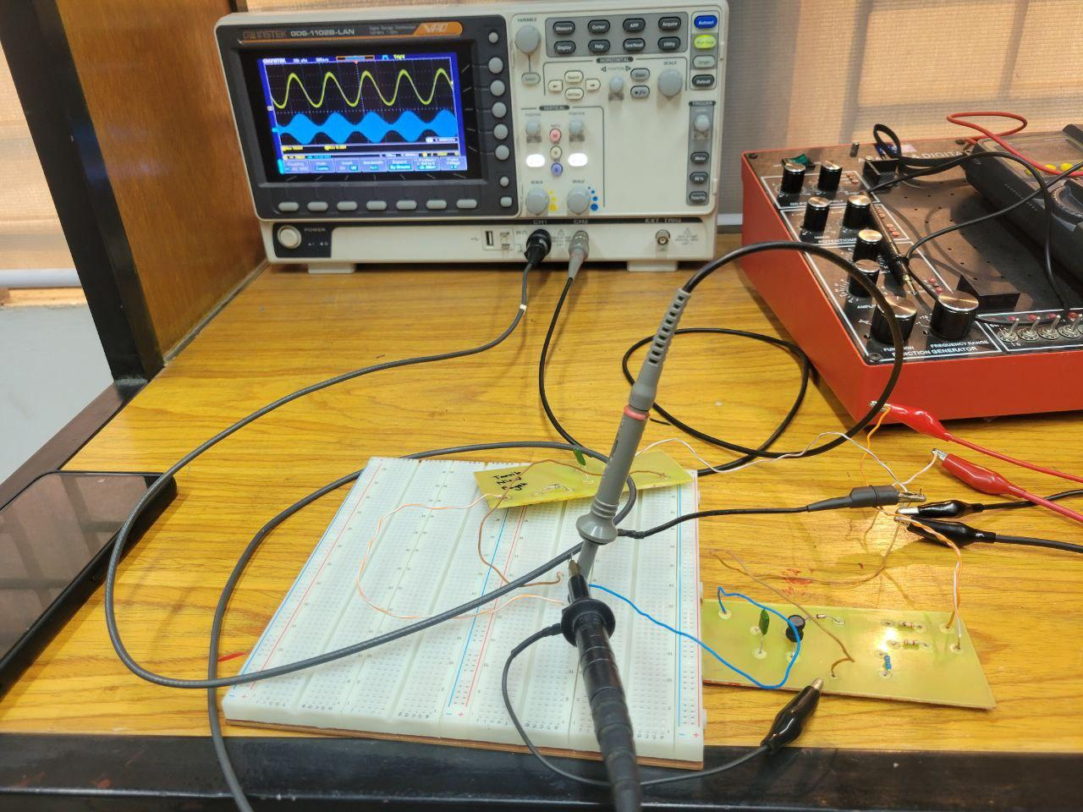
Experimental Setup
Test Procedure:
  Connected carrier input (~160 kHz) from a function generator to the modulator.
  Applied a 1 kHz modulating signal.
  Observed modulated output on an oscilloscope.
  Fed modulated signal into the demodulator.
  Measured demodulated output on a separate oscilloscope channel.

Slide 13
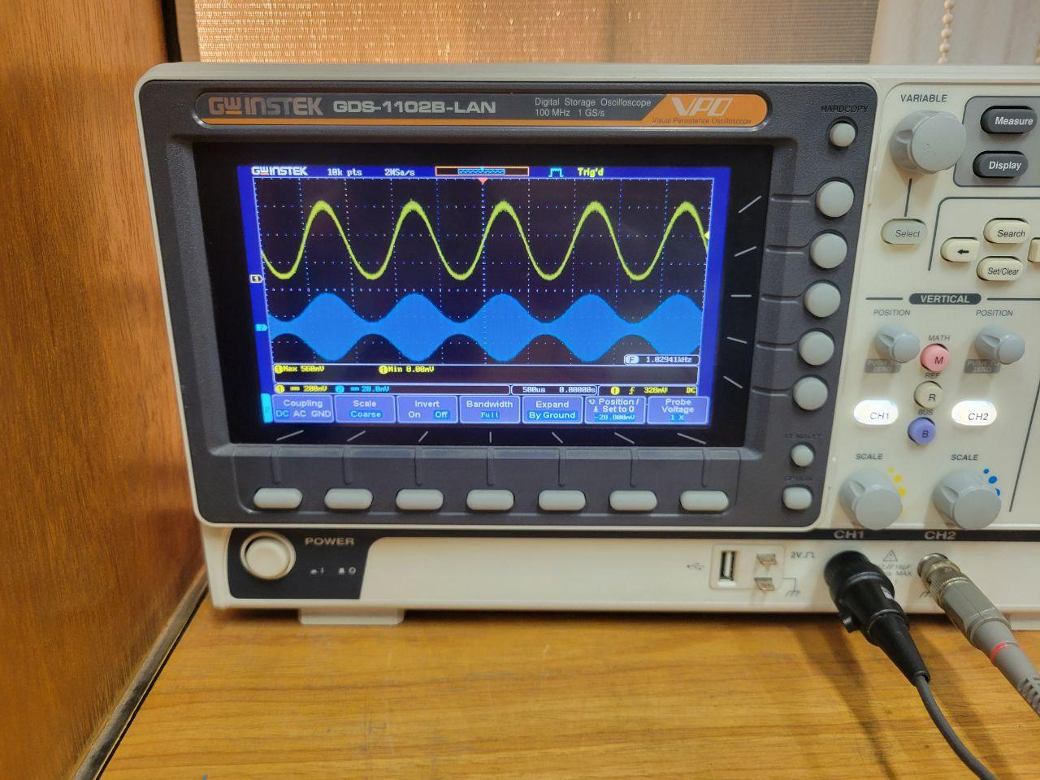
Oscilloscope Observations
  Modulator Output:
    Displayed a carrier wave with amplitude variations matching the audio input.
  Demodulator Output:
    Recovered envelope closely matched the original modulating signal.

Slide 14
Thank You

